Slide 1
Back to basic – Educational series Income tax
Salaries & Income from house property
By
CA ABHINAYA M A

Slide 2
What’s in?
Salaries
Section 15 – Charging section
Section 16 - Deductions
Section 17 – Definitions
Income from house property
Section 22 – Basis of Charge
Section 23 – Definition of Annual value of house property
Section 24 – Deductions
Section 25 – Inadmissible deduction
Section 26 – Income from co-owned property
Section 27 – Deemed ownership

Slide 3
Salaries
(Section 15 to 17 of the Income-tax Act, 1961)

Slide 4
Chargeability of income
Section 4 – Charging section
Section 2(24) – Definition of “Income”
Section 5 – Scope of total income
ROR – Global income
RNOR / NR – Only those income which are deemed to accrue / arise in India (or) received in India
Section 6 – Residential status
Section 9 – Income deemed to accrue or arise in India
9(1)(ii) income which falls under the head "Salaries", if it is earned in India.
Explanation.—For the removal of doubts, it is hereby declared that the income of the nature referred to in this clause payable for—
(a) service rendered in India; and
(b) the rest period or leave period which is preceded and succeeded by services rendered in India and forms part of the service contract of employment, shall be regarded as income earned in India ;
(iii) income chargeable under the head "Salaries" payable by the Government to a citizen of India for service outside India ;

Slide 5
Section 15 – Charging section
Income from salaries
On due basis
On receipt basis
Salary
Paid or payable or allowed
By present or past employer to employee
Taxable on due basis or receipt basis, whichever is earlier
No dual taxation
Salary, bonus, commission or remuneration etc. due to, or received by, a partner of a firm from the firm - Not regarded as "salary” (Explanation 2 inserted vide Finance Act., 1992)

Slide 6
Case study 1
Employer – employee relationship
Supervise and control the work done by employee
Directing the employee to work in a particular manner (SC – D C Works Ltd. vs. State of Saurashtra (1957) SCR 152
Responsibility to bear losses (Allahabad HC - Bhargava (KP) v. CIT (1954) 26 ITR 489)
Right of selection and of suspension or dismissal
Regularity in payment of remuneration
Relationship ceases on acceptance by employer of resignation or request for voluntary retirement (Baljit Singh v. State of Haryana (1997) 1 SCC 754 and Power Finance Corpn Ltd. v. Pramod Kumar Bhatia (1997) 4 SCC 280

Slide 7
Case study 2
Can a HUF be an employee?
Yes. Managing Director – CIT vs. Kalu Babu Lal Chand [1959] 37 ITR 123
Individual capacity
Usage of funds of HUF to take up the position
Treasurer of a bank - Piyare Lal Adishwar Lal v. CIT (1960) 40 ITR 17, 24 (SC)

Slide 8
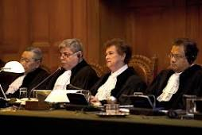
Case study 3
Is employer necessary?
Deoki Nandan Agarwala (Justice) v. Union of India (1999) 237 ITR 872 (SC) – Judges of Courts are also employees and their income is taxable as ‘Salary’; What is relevant is employment and not so much the presence of employer as understood in the conventional sense.

Slide 9
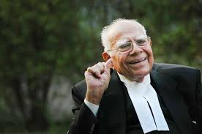
Case study 4 – Profession vs employment
In an employment, person occupies a post or an office.
An office is a subsisting, permanent, substantive position which has an existence independent of the person who fills it, which goes on and on and is filled in succession by successive holders (Per Rowlatt, J, in Great Western Railway Co v Bater (1920) 3 KBD 266)

Slide 10
Case study 5 – ‘Due’ basis
CIT v. L.W. Russel [1964] 53 ITR 91 (SC) - there shall be an obligation on the part of the employer to pay the amount and a right on the employee to claim the same.
ITO v. Dr. Y.K. Hamied [1988] 25 ITD 88 (Bom. - Trib.) - The word 'due' means the right to demand payment as arisen to the employee and such right should arise from the contract of service.
Applicability to perks and benefits

Slide 11
Case study 6 – Tips collected
Tips collected by hotel from guests on behalf of employees
Not taxable as ‘Salary’ since contract of employment was not a proximate cause for receipt of TIPS (EIH Ltd. v.s TDS officer [2017] 78 taxmann.com 242 (Delhi - Trib.))

Slide 12
Section 16 – Deductions
Standard deduction – INR 50,000 p.a. for an assesse
Entertainment allowance for Govt. employees granted by an employer to the assessee who is in receipt of a salary from the Government – 1/5th of salary (exclusive of any allowance, benefit or other perquisite) or INR 5,000, whichever is less;
Professional tax paid

Slide 13
Section 17(1) - salary
Inclusive definition
Salary
Wages
Annuity or pension
Gratuity
Fees, commissions, perquisites or profits in lieu of or in addition to salaries
Advance salary
Leave encashment
Annual contribution > 12% of salary and annual accretion > 9.5% p.a. towards RPF
Employer’s contribution towards NPS/ agniveer corpus fund
Refer slide 14
Refer slide 15
Refer slide 16 and 18 onward..
Refer slide 17

Slide 14
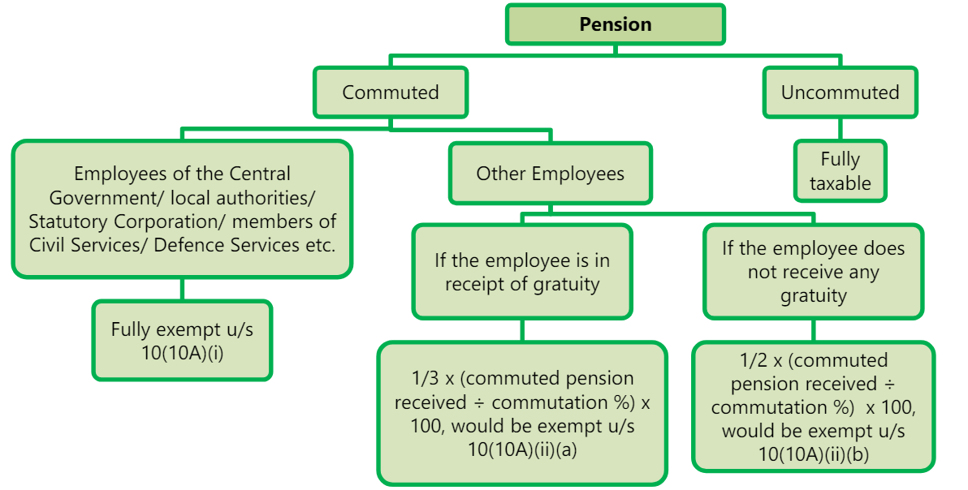
Pension

Slide 15
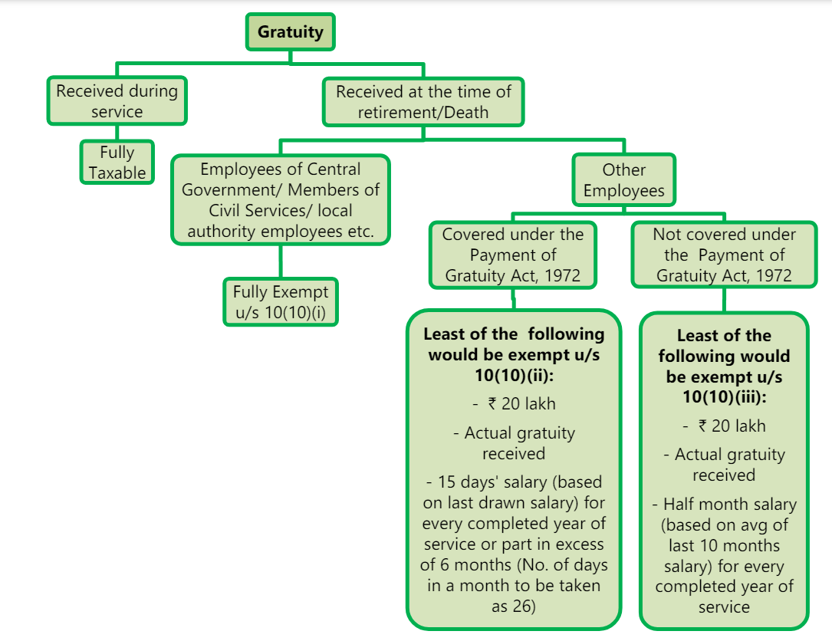
Gratuity
Salary = Basic + DA (provided in terms of employment) + Commission as a fixed %
Salary = Basic + DA

Slide 16
Section 17(3) – profit in lieu of salary
Compensation on account of termination of employment
Compensation on account of modifications of terms and conditions of employment
Payment from PF / other funds
Keyman insurance policy
Payment received before joining / after cessation of employment

Slide 17
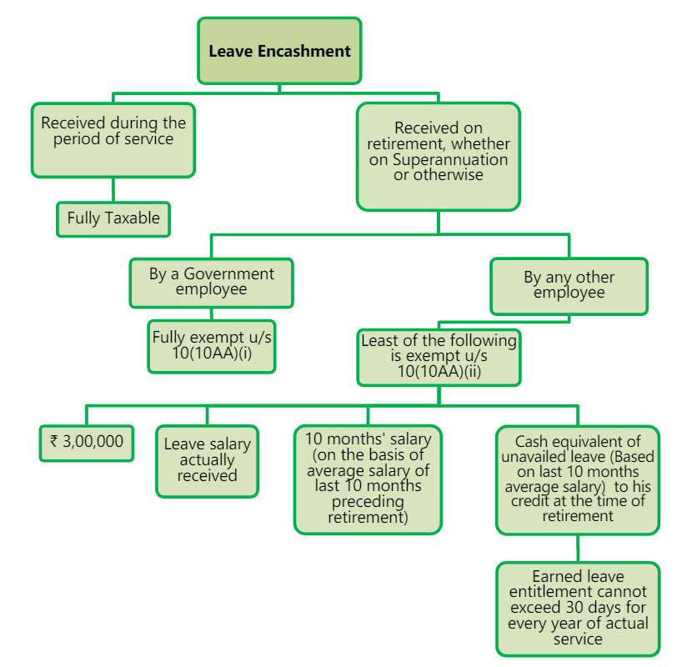
Leave encashment
Salary = Basic + DA (provided in terms of employment) + Commission as a fixed %

Slide 18
Section 17(2) – perquisite
Nature of perquisite | Valuation as per Rule 3
Section 17(2)(i) Rent free accommodation | House property accomodation 1. Government employee - License fees as per house allotment scheme of the Government + 10% p.a. of furniture cost / actual hire charges of furnishings 2. Non-Government employees - If the house is owned by employer: 10% of salary if city population > 40L 7.5% of salary if city population is between 15L & 40L 5% of salary in other cases If the house is taken on lease by employer: 15% of the salary or lease rent, whichever is lower. + 10% p.a. of furniture cost / actual hire charges of furnishings Hotel accommodation (except for 15 days on transfer) 24% of salary paid or payable or actual charges payable to Hotel – Lower
Section 17(2)(ii) Rental concession | Rent recovered from employees to be reduced from above
Exception - Accommodation in a remote mining site/ dam site/ oil exploration site / project execution site
Salary excludes DA, employer’s contribution to PF, other perks valuation
Notes:
Black’s law dictionary - A privilege or benefit given in addition to one’s salary or regular wages
Advanced law lexicon – Something which arises by reason of a personal advantage

Slide 19
Section 17(2) – perquisite (Contd..)
CBDT Notification No. 65/2023 dated 18th August, 2023 along with corrigendum in Notification No. 72/2023 dated 29 August 2023
2001 census
2011 census
W.e.f. September 1, 2023
Rationalization in valuation:
Formula – Perquisite value in first PY * CII of the relevant PY / CII of the first PY
Example – Mr. X is employed in Cognizant in Chennai. He is paid a salary and provided a rent free accommodation
Year | Salary | Perquisite value
FY 2021-22 | INR 20,00,000 | INR 3,00,000
FY 2022-23 | INR 23,00,000 | INR 1,43,750 (5 months) + INR 2,01,250 (7 months)
FY 2023-24 | INR 26,50,000 | INR 2,65,000
FY 2024-25 | INR 32,00,000 | Lower of INR 3,20,000 (or) INR 2,65,000 * 362 (assumed) / 348 – INR 2,75,661
Notes:
the increase in salary of the employee does not result in an artificial rise in the value of the perquisite beyond the inflation level in the country by way of introducing an inflation-linked cap in determining the value of perquisite.

Slide 20
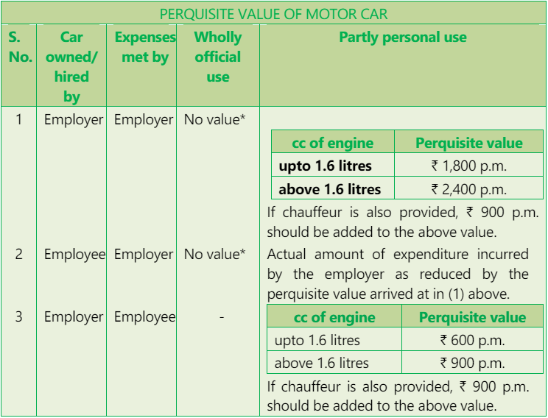
Section 17(2) – perquisite (Contd..)
Nature of perquisite | Valuation as per Rule 3
Section 17(2)(iii) any benefit or amenity granted to An employee who is a director An employee whose salary > INR 50k An employee having a substantial interest in the company Exclusion – Use of vehicle for traversing from office to house and vice versa | Use of motor car (Rule 3(2)) Fully personal use – Running and maintenance expenses incurred + Normal wear and tear @ 10% p.a.
Section 17(2)(iv) Meeting obligation of employee

Slide 21
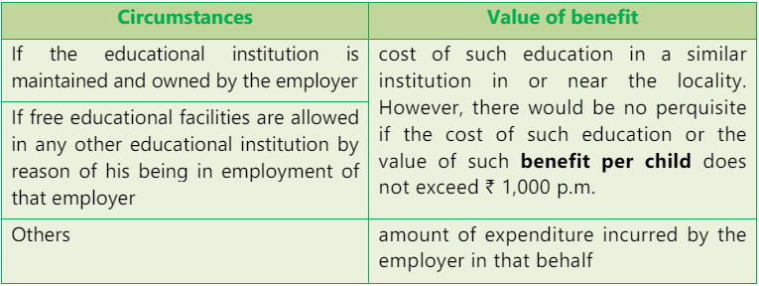
Section 17(2) – perquisite (Contd..)
Nature of perquisite | Valuation as per Rule 3
Section 17(2)(iii) and (iv) contd.. | Domestic servants (Sweeper, gardener, watchman, personal attendant) (Rule 3(3)): Total salary paid or payable less recovery from employee Gas, Electricity, water (Rule 3(4)): Resources owned by employer – Manufacturing cost per unit Resources availed from agent – Amount paid to such agent Free / concessional educational facilities to employee’s children / member of household (Rule 3(5)):

Slide 22
Case study 7 – higher education
Mr. X, employed in TCS pursues MBA program, the cost of which is reimbursed by the employer. Is this a perquisite?
Delhi ITAT – Natwarlal Gupta v. ITO (2004) 2 SOT 793 (Del)
Assessee was a qualified CFA and working as an employee
Assessee executed a bond in favour of company to serve the company for 7 years failing which education cost spent will be recovered by employer
Decision to undergo higher education was that of employer and not employee
Held – Not a perquisite – section 17(2)(iv) of the IT Act
Section 17(2)(iii) – Not addressed

Slide 23
Section 17(2) – perquisite (Contd..)
Nature of perquisite | Valuation as per Rule 3
Section 17(2)(iii) and (iv) contd.. | Free or concessional tickets (Rule 3(6)) Employer is engaged in carriage of passenger or goods Provision of free or concessional journey to employee or member of his household Personal / private journey Value = Value at which such facility is offered to public – Recovery from employee Exception – Airline or Railways
Section 17(2)(v) – Employee’s life assurance other than through RPF, Superannuation, EDLI, etc. | -
Section 17(2)(vi) – ESOP | Valuation of ESOP (Rule 3(8) – Equity shares and Rule 3(9) – Other instruments) FMV as on date of exercise of option Equity shares listed on one recognized stock exchange – Avg of opening and closing price Equity shares Listed on > 1 recognized stock exchange – Avg of opening and closing price in stock exchange with higher volume of trading No trading in equity shares on the said date – Closing price of closest and immediately preceding date in stock exchange with higher volume of trading Equity shares not listed – Value determined by merchant banker (180 days validity) Other instruments – Value determined by merchant banker (180 days validity) Relaxation for a Start up employer – ESOP taxable in the earlier of - after expiry of 48 months from end of relevant AY Year of sale of security Year of cessation of employment

Slide 24
Section 17(2) – perquisite (Contd..)
Nature of perquisite | Valuation as per Rule 3
Section 17(2)(vii) – Contribution in excess of INR 7.50 lakhs towards RPF, NPS, superannuation fund | -
Section 17(2)(viia) – Annual accretion on the above contribution | Rule 3B
Section 17(2)(viii) – Any other fringe benefit | Rule 3(7) Interest free or concessional loan made available to employee / member of household SBI interest rate as on 1st day of PY in which loan was given * Max O/s monthly balance Exception – Loans not exceeding INR 20,000, Loan towards medical treatment Travelling, touring and accommodation Expenditure incurred by employer on behalf of employee
Interest rate
* Excess contribution
2
Interest rate
* Excess contribution and interest perks earlier PYs in since 2020-21
2

Slide 25
Section 17(2) – perquisite (Contd..)
Nature of perquisite | Valuation as per Rule 3
Section 17(2)(viii) – Any other fringe benefit | Rule 3(7) Free or concessional foods / beverages Expenditure incurred by employer on behalf of employee except for – those provided during working hours at office premises / remote location Provided through paid vouchers which are not transferable and usable only at eating joints not exceeding INR 50 per meal Tea and snacks provided during working hours Gift, voucher, token in lieu of such gift Amount of such gift Perk would be NIL if gift value < INR 5,000 Credit card expenses Official – Not a perk Personal – Amount incurred Club expenses Official – Not a perk Personal - Amount incurred (Initial fee not included) Exception – Health club, sports and similar facilities provided uniformly to all employees by employees

Slide 26
Section 17(2) – perquisite (Contd..)
Nature of perquisite | Valuation as per Rule 3
Section 17(2)(viii) – Any other fringe benefit | Rule 3(7) Use of moveable assets Laptops and computers – NIL Others – 10% p.a. / actual rent payable by employer Transfer of moveable assets Depreciated value of asset Computers and electronic items – 50% p.a. on WDV for completed years Motor cars – 20% on WDV Other assets – 10% on SLM Any other benefit Cost incurred by employer on an Arm’s length transaction less recovery from employee Exception – Expenses on telephone including mobile phone

Slide 27
Income from house property
(Section 22 to 27 of the Income-tax Act, 1961)

Slide 28
Chargeability of income
Residential status | Taxability of income from house property
Resident and ordinarily resident | Global income taxable
Resident but not ordinarily resident | Income from domestic property – Taxable Income from foreign property – Not taxable unless rent is received in India
Non resident | Income from domestic property – Taxable Income from foreign property – Not taxable unless rent is received in India

Slide 29
Section 22 – Basis of charge
Income from house property.
22. The annual value of property consisting of any buildings or lands appurtenant thereto of which the assessee is the owner, other than such portions of such property as he may occupy for the purposes of any business or profession carried on by him the profits of which are chargeable to income-tax, shall be chargeable to income-tax under the head "Income from house property".
Annual value of property shall be chargeable to income tax under this head if -
“Property” should consist of buildings or lands appurtenant thereto
Assessee must be the “owner” of property
The property should not be held for the purpose of carrying on any business or profession

Slide 30
Section 27 - Deemed owner
Transfer of property to spouse except for adequate consideration / agreement to live apart
Transfer of property to minor child except minor married daughter
Holder of impartiable estate (Indivisible property)
Member of co-operative society to whom house property is allocated under a house building scheme of a society / company / association
Person in possession of property in part performance of contract under section 53A of Transfer of Property Act
Person having rights in a property for a period >= 12 years

Slide 31
Case study 8
X & Co. (Owner)
Shopping malls/business centres are located in X & Co.’s premises
X & Co.’s responsibility
Providing security, communication and other services
Keep open the business centres from 9 A.M. to 10 P.M. every day.
Permit the employees of the users free access to the aforesaid services
User’s responsibility
Not permitted to allow any person to sleep or stay in any part of the building nor to use the same for residential purposes.
Only granted permissive user of the services and facilities provided in the premises by X & Co..
No right, title or interest of any kind in the services and facilities provided by X & Co., No tenancy right or occupancy
The service charges payable by the users had been determined at a fixed rate.
PFH Mall & Retail Management Ltd.
[2008] 110 ITD 337 (Kolkata) ITAT
Objective of lessor to be seen
If the main intention is for simply letting out property or any portion thereof - IFHP
If the main intention is found to be the exploitation of the immovable property by way of commercial activities - PGBP
Users
Noor resorts (P.) Ltd. [2022] 145 taxmann.com 353 (HP)
Renting as a business – PGBP and not IFHP
Nisarg Realtors (P.) Ltd. [2022] 139 taxmann.com 163 (Mum ITAT)
MoA object clause – to acquire properties such as land and building and also to earn rental income
S.N.Damani Infra (P.) Ltd. [2022] 138 taxmann.com 381 (Chennai)
MoA object clause – to provide warehouse and supply chain solutions
Rental income – taxable under IFHP

Slide 32
Computation of IFHP
Particulars | Amount in INR
Gross Annual Value – Section 23 | Xxx
Less: Municipal Taxes – Proviso to Section 23 | (xx)
Net Annual Value | Xxx
Less: Deductions – Section 24 | (xx)
Income / (Loss) from House Property | xxx

Slide 33
Characterization of house property
Property
Self – Occupied
Let out
Deemed to be Let out
Self-occupied property (or) not occupied owing to employment / business / profession carried on at another place and he has to reside at that place
Max allowed – 2
>2 self occupied property at the option of taxpayer
Let out for whole or part of the PY
Not a self occupied if property is let out during any part of the PY / any other benefit derived by owner

Slide 34
Section 23 – Gross annual value
Property
Self – Occupied
Let out
Deemed to be Let out
Annual value - NIL
Gross Annual Value = Higher of Expected Rent or Actual Rent
Gross Annual Value = Expected Rent
Expected Rent = Municipal valuation or Fair Rent whichever is higher restricted to Standard rent
If Actual rent < Expected Rent on account of vacancy, actual rent is considered
Rule 4 – Unrealised rent can be reduced from actual rent
Tenancy is bonafide
Defaulting tenant is vacated / steps taken to compel him to vacate
Tenant not in occupation of any other property
Taken all reasonable steps to institute legal proceedings / such proceedings will be useless

Slide 35
Relaxations from annual value
Unrealised rent
Unsold property
Rule 4 – Unrealised rent can be reduced from actual rent
Tenancy is bonafide
Defaulting tenant is vacated / steps taken to compel him to vacate
Tenant not in occupation of any other property
Taken all reasonable steps to institute legal proceedings / such proceedings will be useless
Section 23(5)
Property is held as stock-in-trade
the property or any part of the property is not let during the whole or any part of the PY
Annual value of such property or part of the property, for the period upto 2 years from the end of the FY in which the certificate of completion of construction of the property is obtained from the competent authority = NIL

Slide 36
Section 23(1) proviso – Municipal taxes
Municipal taxes are deductible if –
Borne by the owner of house property
Actually paid during the PY
Not a self-occupied property
Whether municipal taxes paid outside India for foreign house property is allowed as a deduction?
Yes; CIT vs. R Venugopala Reddiar (Madras HC) [1965] 58 ITR 439
Whether municipal taxes originally paid by tenant but later reimbursed by owner deductible?
Yes

Slide 37
Section 24 - Deductions
Standard deduction
Allowed @ 30% of NAV
No supporting documents required
No actual incurrence required
Interest on capital borrowed
For Purchase or construction
Self occupied – INR 2,00,000 provided construction or acquisition should be completed within 3 years from end of FY in which loan was taken (Else, limit – INR 30,000)
Let out / deemed to be let out – No limit
For repairs and renewals or reconstruction
Self occupied – INR 30,000
Let out / deemed to be let out – No limit
Allowed on accrual basis; No requirement to actually pay interest
Pre-construction interest – allowed over a 5-year period
No restriction on lenders; Even relatives and friends can be lenders

Slide 38
Case study 9
Whether interest on overdue interest claimable?
No
Whether interest on purchase consideration paid belatedly would be allowable under section 24(b)?
Yes; CIT v. Sunil Kumar Sharma [2002] 173 CTR 368 and CIT v. Master Sukhwant Singh [2005] 196 CTR 122
Whether interest payable on fresh loan taken to repay the original loan raised earlier deductible?
Yes; Pursuant to CBDT Circular no. 28 dated 20th August 1969

Slide 39
Case study 10
Can a Trust claim deduction under section 24(b)?
View 1 – No; Trust cannot claim deduction as it is subject to application under section 11
Mumbai Tribunal in the case of Nandlal Tolani Charitable (2019) 105 taxmann.com 232
Surat Tribunal in the case of Amalsad Vibhag Kelvani Mandal (2023) 156 taxmann.com 70 (Sathya Sai ruling considered as per incuriam)
View 2 – Yes as no category of taxpayers are specifically excluded under section 24
Mumbai Tribunal in the case of Shantaram Bhat Charitable Trust [2020] 113 taxmann.com 262
Mumbai Tribunal in the case of Sri Sathya Sai Trust [IT Appeal no. 7350 (Mum) 2011, vide order dated 25-3-2013

Slide 40
Section 25, 25A and 26
Section 25
Interest payable outside India is not deductible while computing IFHP unless tax has been paid or deducted at source on such interest
Section 25A
Section 26 – Joint property
Characterization – Can be seen qua the property owner
Computation of taxable income - Income calculated at property level and apportioned to each co-owner

Slide 41
foreign property taxation
Impact of DTAA
Scope of income
State of taxation
Taxable in the hands of
ROR (irrespective of place of receipt of income) and
RNOR / NR, only if rent is received in India
ARTICLE 10
INCOME FROM IMMOVABLE PROPERTY
Income from immovable property may be taxed only in the territory in which the property is situated. For this purpose any rent or royalty or other income derived from the operation of a mine, quarry or any other place of extraction of natural resources shall be regarded as income from immovable property.
India – Greece DTAA
India – UK DTAA
ARTICLE 6
INCOME FROM IMMOVABLE PROPERTY
Income from immovable property may be taxed in the Contracting State in which such property is situated.
(a) The term "immovable property" shall, subject to the provisions of sub-paragraph (b) of this paragraph, be defined in accordance with the law of the Contracting State in which the property in question is situated.
The term "immovable property" shall in any case include property accessory to immovable property, livestock and equipment used in agriculture and forestry, rights to which the provisions of general law respecting landed property apply, usufruct of immovable property and rights to variable or fixed payments as consideration for the working of, or the right to work, mineral deposits, sources and other natural resources. Ships and aircraft shall not be regarded as immovable property.
3. The provisions of paragraph (1) of this Article shall apply to income derived from the direct use, letting, or use in any other form of immovable property.
4. The provisions of paragraphs (1) and (3) of this Article shall also apply to the income from immovable property of an enterprise and to income from immovable property used for the performance of independent personal services.

Slide 42
Recent litigation trends
Claim of exemptions and deductions against salary – Section 133(6) notices to employers to cross check claims made by Employees in their ROI
Characterization of income (IFHP, IFOS etc.) to be substantiated with facts
Documentation for deduction claims under section 24(b) – Residential vs commercial
DTAA claims
Documentation for exemption (say, HRA, Gratuity, Pension etc.)
Reimbursement of expenses to employees
Salary
House Property

Slide 43
Thank you
CA ABHINAYA M A
Email – abhinaya98@gmail.com
Ph - 8939155650

